Slide 1
FC Continuing Education Series
Data Quality Assurance During Data Collection
Prepared by DIME Analytics
dimeanalytics@worldbank.org
Presented by Roshni Khincha
rkhincha@worldbank.org

Slide 2
Data Quality
“The quality of the data we collect plays a key role in driving the quality of our decision-making”
Christopher Robert, SurveyCTO
What is quality data?
Notes:
Quality data is accurately recorded data which is representative of the respondents data is being collected from (that is, data free from errors and biases)

Slide 3
Data Quality
Think of everything that might go wrong…
Incorrect recording of answers
Broken tablet or empty battery
Sample attrition
Answers entirely made up
Programming bugs
No phone signal
Respondent doesn’t understand the question
Wrong person interviewed
... and make a plan for pre-empting it

Slide 4
Data Quality for Primary Data Collection
Consider data quality throughout
Pre-field
Survey programming
Enumerator training
During the field
Communication and reporting system
Post-field
Final field report
Field monitoring
Minimizing attrition
Real-time data quality checks
Back-checks
Data cleaning
Notes:
Field controls vs data controls

Slide 5
Today’s focus: During the Field
Pre-field
Survey programming
Enumerator training
During the field
Communication and reporting system
Post-field
Final field report
Field monitoring
Minimizing attrition
Real-time data quality checks
Back-checks
Data cleaning
Notes:
Looking to:
Make sure that all surveys that were done are received
Look out for systematic problems in the data received (global or enumerator level)
Ensure that the data collected in each survey is correct (individual survey level)

Slide 6
Communication and reporting system

Slide 7
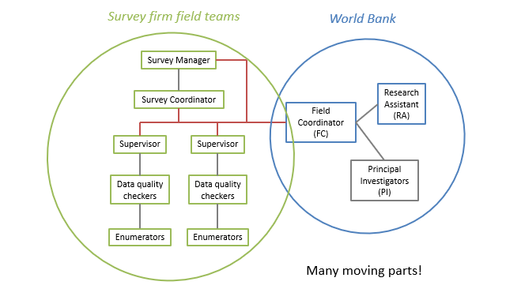
Survey Team Structure
Notes:
Enumerators should not report to you
Share reports, observations, errors with the survey coordinator and supervisors

Slide 8
Good communication is key! → Within the team
Feedback & corrections
Share reports, observations, error sheets, etc. with the survey coordinator, and/or directly to the field team supervisors (make sure the survey firm agrees with this communication channel)
Enumerators usually should not report to you, field team supervisors can
Field
Coordinator (FC)
Survey coordinators
Share survey progress reports, errors sheet
Field team supervisors and data qualuty checkers
Enumerators

Slide 9
Good communication is key! → Within the team
Set up a good system for reporting feedback!
Create WhatsApp group with you, survey managers/coordinators and supervisors
WhatsApp conversation can be exported & stored on DB
Each team meets at the end of the days for feedbacks, sharing experiences on challenges and success
Get in touch with your survey manager / coordinators everyday for feedback if you couldn't meet them during the day
Keep a diary or log of conversation with teams

Slide 10
Good communication is key! → Within the team
Set up a good system for reporting feedback!
Have a shared Dropbox folder with you, the RA, PIs, survey managers/coordinators, and supervisors where
HFC outputs are stored
Back check files are created
Easy to share these files with the team as files auto-update throughout the data collection period
No need to send an email with the updated results on a daily basis

Slide 11
Good communication is key! → Within the team
Set up a good system for reporting feedback!
Have a shared Dropbox paper with you, the RA, and survey managers/coordinators where
The timeline of the project is located and updated in case of changes
All tasks related to the data collection are listed
Usually assigned to members of the team, and
With deadlines to ensure follow-up
This can be shared with the PIs as well

Slide 12
Good communication is key! → Within the team
Surveys in remote areas can present connectivity issues:
Cannot send survey forms every day
Receiving and sending HFCs and backcheck feedback
Charging tablets
Phone network
What can you do?
Train the supervisors well! – many problems don’t need FC interaction to resolve
Set maximum period before having to check in again / sync tablets (not > 48 hours)
Be creative

Slide 13
An example
We have an ongoing project in Rwanda where a survey firm has been employed to collect data
These are the modes of communication set up
Shared Dropbox folder where
Survey progress is tracked
HFC outputs are stored
Back check files are created
WhatsApp group with the FCs, RA, and survey coordinators
Dropbox paper with FCs, RA, and survey coordinators
To set up timelines
To create to-do lists of tasks and assign to the person in-charge

Slide 14
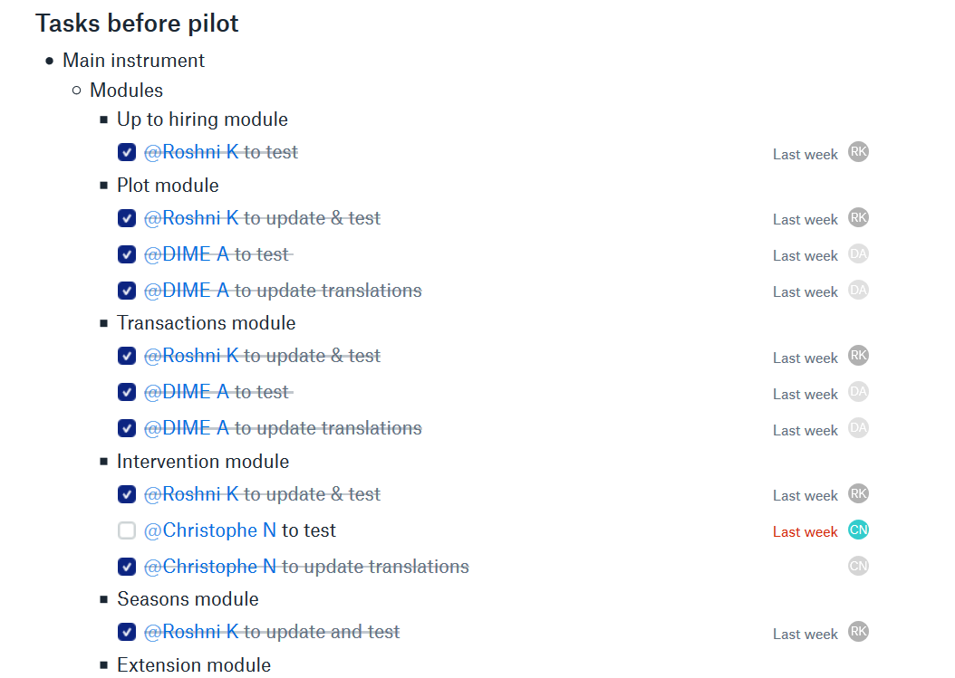
Dropbox paper example

Slide 15
High-frequency checks (HFCs)

Slide 16
What are High-frequency checks?
Definition: Checks run on a daily basis for ALL surveys to provide information about various aspects of the quality of data collected.
Elements of these checks include
The quality of the data
Enumerator performance
The survey programming (are there programming errors?)
The survey progress
ipacheck = IPA Stata package for running high-frequency checks on research data

Slide 17
Categories of High Frequency Checks
Response Quality
Programming
Enumerators
Duplicates and Survey Log
Monitor the consistency of responses across the survey instrument and the range within the responses fall.
e.g. standardizing units, outliers
Revisit the question/ retrain enumerators
Understand if the questionnaire has been designed and programmed properly.
e.g. sensitive questions, categorizations, calculations
Survey form updates
Determine if any individual enumerator's data is significantly different from other enumerators' data.
e.g. percentage of “don’t know”, average interview duration
Enumerators may need more training
Confirm that all the data from the field is on the survey in a sound manner.
e.g. all data is on the server, duplicates
Request corrections from field team

Slide 18
Daily downloads of data support routine checks
Enumerator checks
– Check the percentage of “don’t know” and “refusal” responses by enumerator
– Check the distribution of responses for key questions by enumerator
– Check the number of surveys per day by enumerator
– Check the average interview duration by enumerator
– Check the duration of consent by enumerator
– Check the duration of other modules by enumerator (e.g., anthropometrics, games, etc.)
Project checks
– Overall survey progress relative to planned sample
– Summaries of key research variables
– Two-way summaries of survey variables by demographic/geographic characteristics
– Attrition rates by type and treatment status
– Comparisons of variables with known distributions
– Maps/GIS: all observations where they’re meant to be?
https://github.com/PovertyAction/high-frequency-checks/wiki/Background
Notes:
Good to share but no need to present

Slide 19
High Frequency Checks: Error Source
Is a discrepancy is because:
the enumerator recorded the response incorrectly accidently
the survey programming has inconsistencies/breaks
the enumerator recorded the response incorrectly maliciously (to save time by skipping sections, repeat counts, etc.)
the survey form got submitted multiple times to the server
2 enumerators surveyed the same respondent

Slide 20
High Frequency Checks: Dealing with Errors
Response Quality
Programming
Enumerators
Duplicates and Survey Log
Share daily log of what can be fixed in case of accidental entry errors. Closely monitor in case it’s particular enumerators with these errors.
Update the programming of the survey and test extensively. Ensure the updated version of survey is used on all tablets.
Should start conversations in the management team.
Possible actions: re-training, meetings to review protocols and editing the questionnaire
Share a report with the field team and identify reasons for low completion rate. In case of duplicate IDs, identify the correct response to keep.

Slide 21
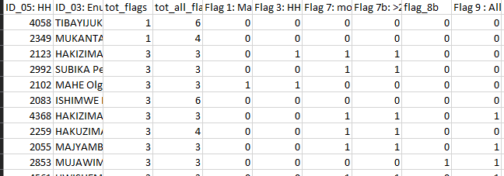
High Frequency Checks Example
Response quality checks

Slide 22
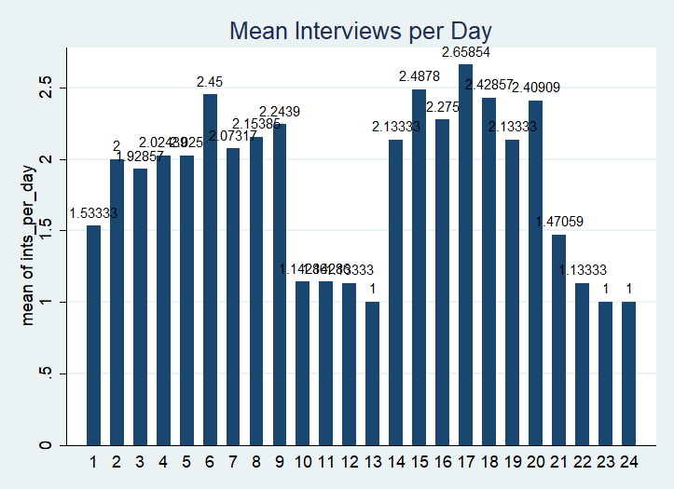
High Frequency Checks Example

Slide 23
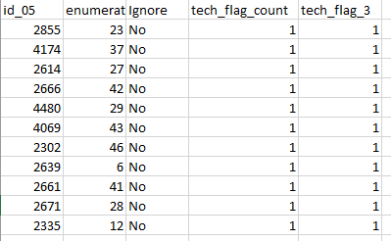
High Frequency Checks Example
Programming checks

Slide 24
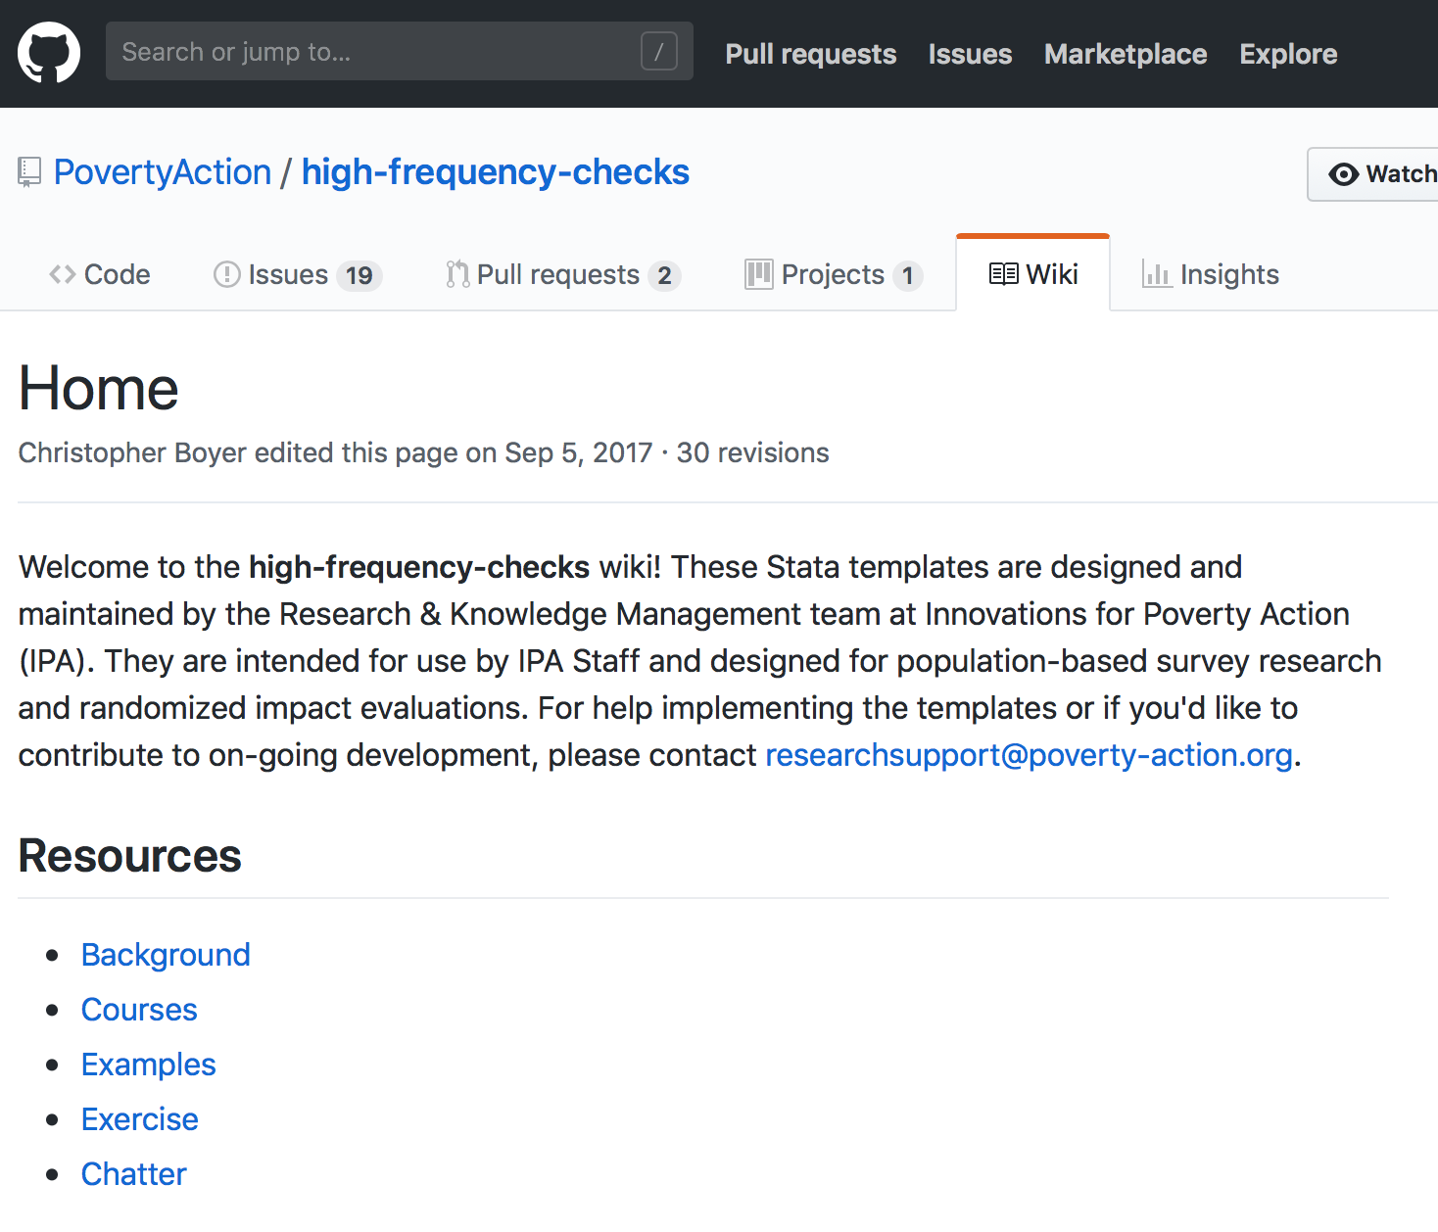
In the office: High-frequency checks
Done by you:
Prepare code / instructions for HFCs before the survey goes to field
Monitor flags reporting and address in the field
Done by the research assistant:
Maintain HFC code
Daily data download
Daily flags reporting
This should be a one-click process
https://github.com/PovertyAction/high-frequency-checks

Slide 25
Backchecks

Slide 26
Backchecks
Definition: An experienced enumerator re-visits shortly after the interview and asks selected questions again (10-15 min)
The answers are compared with the original survey
Every team and every surveyor must be backchecked as soon as possible, and regularly. Frontload the backcheck sample
10-20% of sample, with 20% being administered in the first 2 weeks of field work
Random sub-sample – select it in advance if data is available
Include missing respondents to verify that your team is not biasing your sample by not tracking hard to find respondents.
Observations flagged in other quality tests
Surveys of enumerators suspected of cheating

Slide 27
Backcheck Survey
Identifying Respondent and Interview Information
Identifying information - make sure it’s the right person
Were you interviewed? On which day, what time of day?
Was the enumerator friendly, annoying, rude, or (s)he was just ok?
Who was present during the back-check interview
If the back-check cannot be done, reasons why

Slide 28
Categories of Backcheck Variables
Type 1
Type 2
Type 3
Straightforward questions where we expect very little variation.
e.g. age, education, relation to household head, floor type
Serious enumerator problem
Enumerators may need more training
Questions where we expect capable enumerators to get the true answer.
e.g. sensitive questions, categorizations, calculations
Are we asking the question in the right way? Are respondents changing their answers because they don’t know?
e.g. It depends on your instrument. They are questions about the survey, not surveyor, performance
Survey needs improvement

Slide 29
Back Checks: Error Source
Is a discrepancy is because:
the respondent understood the question both times but decided to change their answer
the respondent hadn’t understood the question initially
the respondent didn’t understand the question during the back-check
the enumerator recorded the response incorrectly accidently
the enumerator recorded the response incorrectly maliciously (to save time by skipping sections, repeat counts, etc.)
→ Third visit or call in case of high rates of discrepancy.

Slide 30
Back Checks: Dealing with Errors
Analysis framework
Set up at the beginning to track deviations early, e.g. “enumerator X always gets his question B wrong” or “question A constantly change across the entire team”
Decide on error thresholds (is a discrepancy of 5% acceptable? 10%?) and what you corrective measures you will take
As field work matures, these decisions can be modified if necessary. The goal is to: (1) record discrepancies, (2) maintain a log of errors and (3) set realistic expectations with clear actionable steps
bcstats = J-PAL/IPA Stata package that automatically compares back-check & main survey data and provides an outline for analysis

Slide 31
Back Checks: Dealing with Errors
Type 1
Type 2
Type 3
Overall error rate >10% 🚩that there may be systemic problems in the questionnaire or administration.
Calculate error rates by team, surveyor and question.
Error rates > 10% should start conversations in the management team. Possible actions: re-training, meetings to review protocols and editing the questionnaire.
Calculate error rates by team, enumerator and question.
The error rates by question should be examined. High error rates should be discussed with PIs. Not good practice to change question wording or structure halfway through the survey!

Slide 32
Back Checks Example
Type 1 Q should never ever change, regardless of interviewer, location or time of day.
Examples of these questions include:
• age at last birthday
• whether currently in school
• highest level of education
• relationship to household head

Slide 33
Back Checks Example
Team error rates

Slide 34
Back Checks Example
Enumerators with error rates above 10%

Slide 35
Back Checks Example
Questions with error rates above 10%
mod1rel_h_head - How is the head of this household related to you?

Slide 36
Alternatives to in-field back checks
 | Positives | Negatives
Audio recording/audits of survey | No extra field time Respondent doesn’t need to be interviewed twice Can randomize the section recorded Provides information on enumerator behavior | Someone has to listen to the audio and analyze the data Audio quality is not guaranteed Requires additional in informed consent
Back checks via phone | Cheaper alternative Quicker to implement | Low response rate is a concern May be hard to probe effectively or ask complex questions Sample can be biased as it depends on which respondents have phone

Slide 37
A quick summary

Slide 38
Summary: Data Quality Checks
High frequency checks (HFCs)
Run on a daily basis for ALL surveys
Check for:
Backchecks
Revisit households to perform short survey (10-15 mins)
Consistency of responses (greater complexity than in programmed survey form)
Outlier values
Programming checks
Enumerator checks
Unique IDs, duplicates, dates
Set up robust and realistic system for addressing issues with field teams
10-20% of the sample, random, frontloaded, for all enumerators
Check for:
Right person interviewed
Identify fraud / time-saving
If enumerator is recording responses correctly
Decide on acceptable thresholds and put in place plan to deal with issues
vs.

Slide 39
Summary: Data Quality Check Workflow
Essential to regularly run HFCs and back checks in first couple of weeks to preempt errors
Produce reports (excel with an issue per row) for both HFCs and backcheck inconsistencies
Be clear about what is required by survey firm to deal with the issue
Verify value? Redo module? Redo interview?
Include info on question number
Avoid having to go back-and-forth over a single data point, especially if each time requires a trip to talk to respondent

Slide 40
Bottom line
Things are going to go wrong!
Plan as much as you can
Establish good communication with your team (internally, at the WB, as well as with implementing partners)
Keep calm and . . . resolve issues as quickly and as effectively as possible

Slide 41
Thank you!

